Slide 1

EdgeTier Interview Task Findings

Slide 2
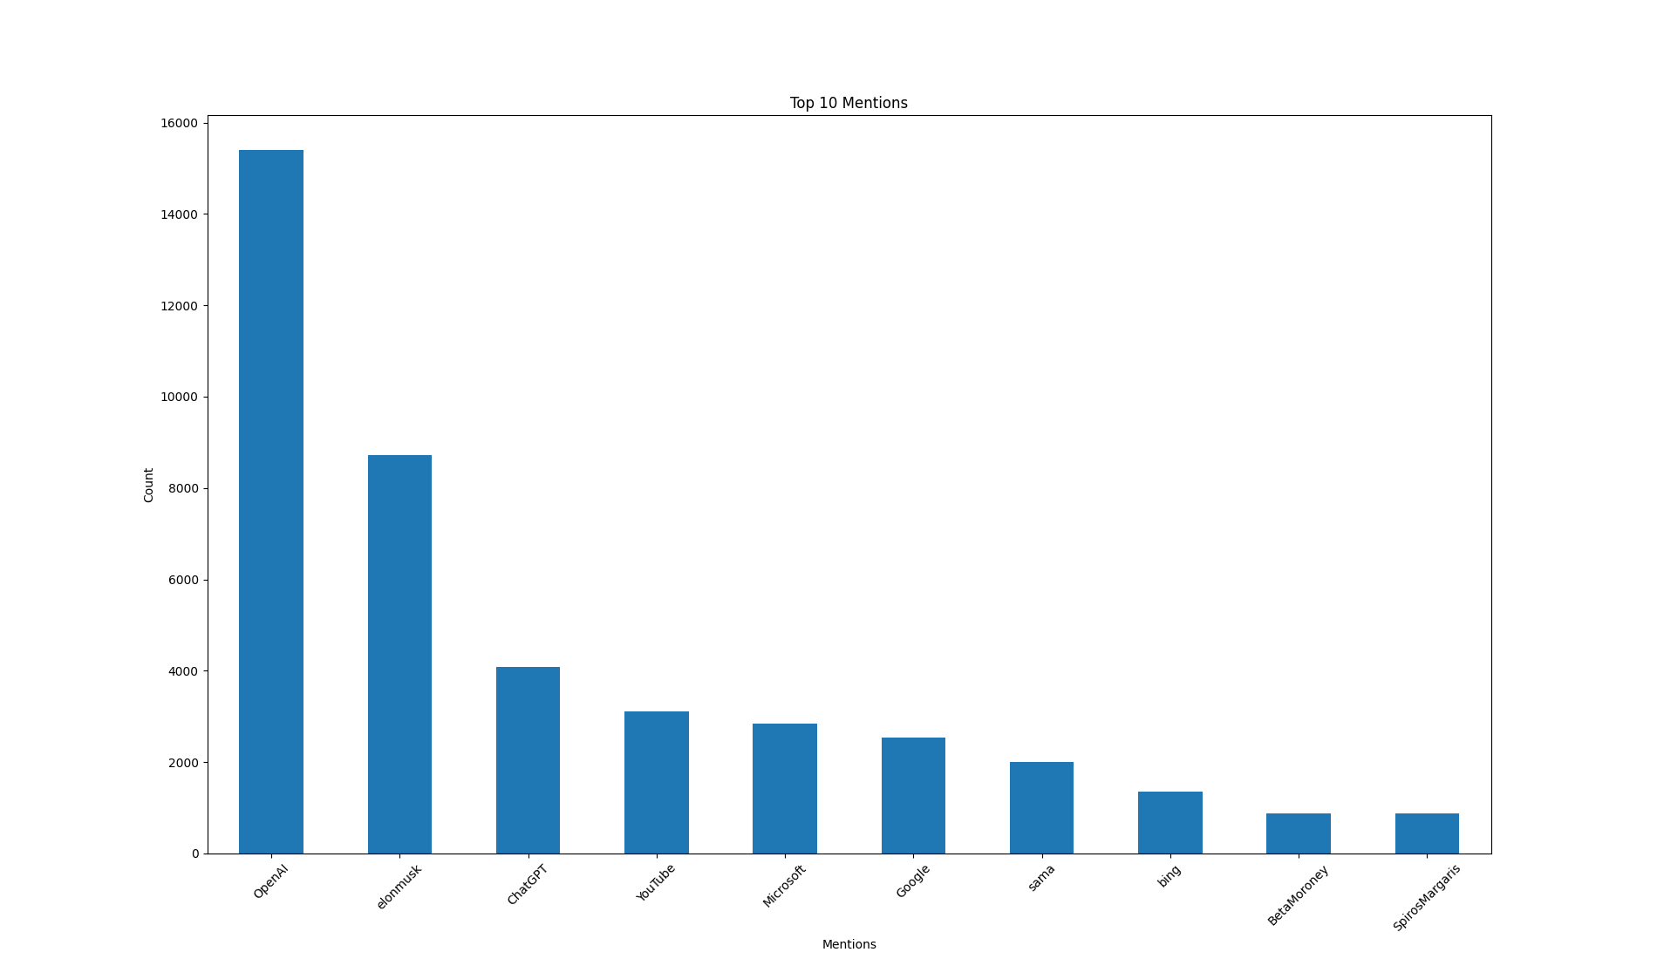
Task 1 – Top 10 Mentions
Approach Taken
Extracted Mentions using occurrences starting with @ in the content column

Slide 3
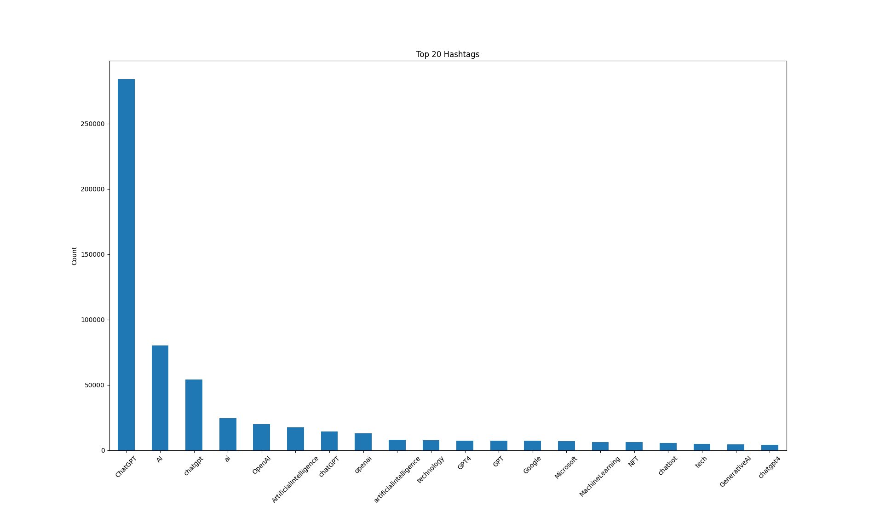
Task 1 – top 20 hasHtags
Approach Taken
Extracted Hashtags using all occurrences starting with # in the content column.

Slide 4
Task 2 – Training binary classifier to predict if a tweet is general technical or not
Approach Taken
  Dataset size: Randomly sampled to 2500 records from the dataset to enhance computation.
  For tagging General Technical Issue or Not
    Zero-shot classification using facebook/bart-large-mnli model
  For Modelling
    Since the target was imbalanced, used a tree-based model RandomForestClassifier after cleaning the text.
  Accuracy – 70 – 75 %
    What can be done better?.
      Data size could be increased, sampling techniques could be tried, ensemble models might work better and push the accuracy.

Slide 5
Next 3 topics suggestion on tweets
Approach Taken
  LDA Model get_document_topics
  Visualisation using pyLDAvis
Experimented
  Bert Topic Modelling

Slide 6
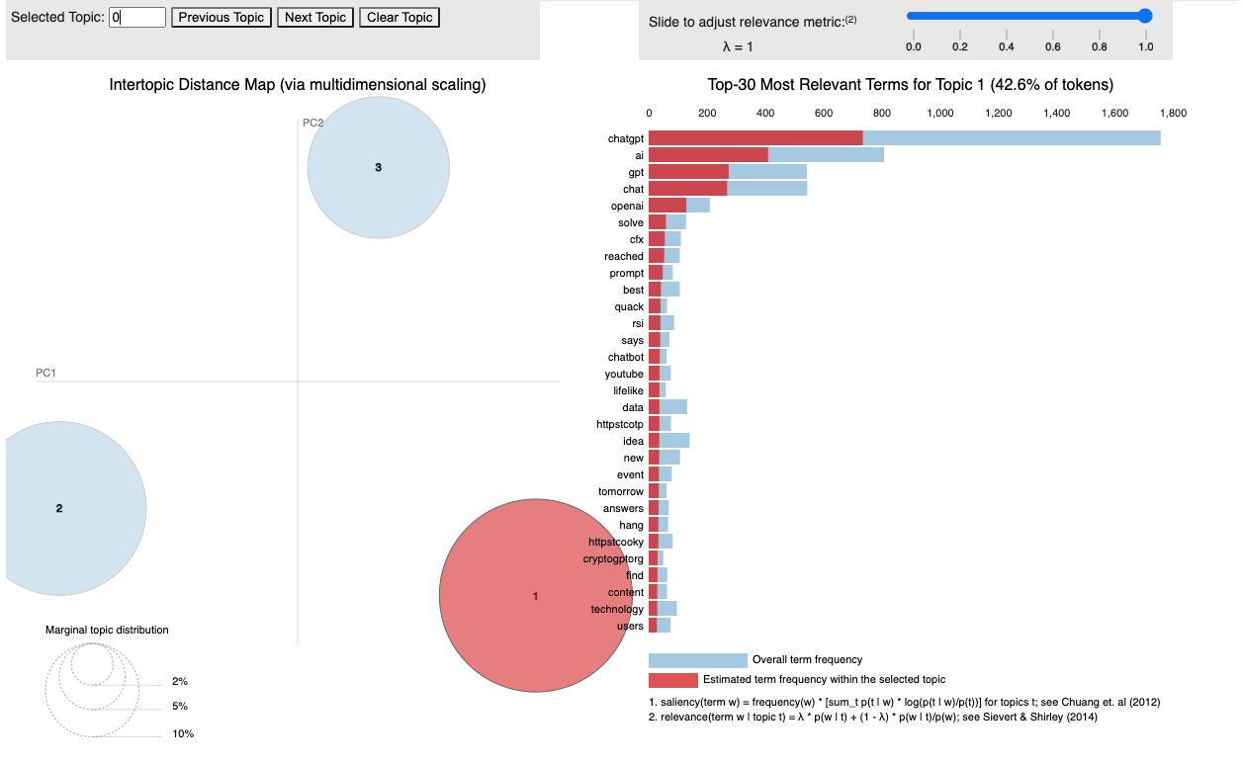
Next 3 topic MODELLING USING LDA

Slide 7
What could be done better overall ?
Could have put all functions in pipeline and use bash command to do all the setup for execution of code like environment and pre-commit hooks set up and run the whole training pipeline in one line of code.
Could have been deployed in Flask or Streamlit
Better approaches to train classifier model.
Things to note
Notebook is parameterized.
All dependencies are provided in the notebook to execute the notebook and a conda.yaml file is attached.
Notebook is detail in explaining things
Task 2 and 3 is using a subset of randomly selected dataset.
GIT LINK:
https://github.com/Muthuramansivakumar/twitter_challenge.git

